Slide 1
IBM University Engagement Project Submission
“Exploring the Power of Agentic AI with IBM Granite and LangFlow”

Slide 2

Project Tile – [Intelligent Market Research Assistant]
Domain of Project – [Independent]
Student Name | Recent Passport Photo | Email ID | Mobile number [WhatsApp]
Suthar Nilkumar |  | sutharnil2@gmail.com | 9016333405

Slide 3
Problem Statement -
Problem Statement : Nutrition Agent
The Challenge
Good nutrition is the foundation of health, but individuals often struggle with diet planning, portion control, and tracking nutritional intake. Information about healthy diets, disease-specific nutrition, and food composition is scattered across unreliable sources. Without personalized, real-time guidance, many fail to maintain balanced diets or make informed food choices.
The Objective
Build an AI-powered Nutrition Agent that delivers personalized dietary insights and guidance for individuals, families, and health professionals. The solution should:
Personalized Diet Plans – Recommend meals based on age, health conditions, allergies, cultural preferences, and fitness goals.
Food Data RAG Retrieval – Fetch and summarize nutritional values (calories, macros, vitamins) from reliable sources.
Diet Tracking & Feedback – Allow users to log meals via text, images, or voice, and provide instant nutritional analysis.
Preventive Health Focus – Suggest diets for chronic disease management (e.g., diabetes-friendly or heart-healthy plans).
Multi-Agent System –
Nutrition Knowledge Agent (fetches nutritional data)
Diet Recommendation Agent (personalized meal plans)
Health Advisory Agent (preventive health suggestions)
Food Log & Feedback Agent (meal tracking + analysis)
Visualization Dashboard – Show daily/weekly nutrient intake, deficiencies, and progress toward health goals.

Slide 4
Proposed Solution -
Our proposed solution is an AI-powered market intelligence platform that helps organizations make faster and smarter business decisions by transforming scattered market information into meaningful insights.
The platform automatically collects data from multiple trusted sources, including news websites, social media, customer reviews, analyst reports, PDFs, CSV files, and other business documents. Using IBM watsonx.ai and IBM Granite LLM, the system analyzes this information to identify market trends, customer sentiment, competitor activities, risks, and emerging opportunities.
A Retrieval-Augmented Generation (RAG) pipeline powered by ChromaDB enables users to upload their own documents and ask natural language questions, receiving accurate, context-aware answers. IBM Orchestrate coordinates multiple AI agents to perform data collection, sentiment analysis, competitor analysis, forecasting, and report generation.
Interactive dashboards present insights through charts, graphs, heatmaps, and KPI cards, allowing decision-makers to monitor business performance in real time. The platform also generates AI-powered reports in PDF, DOCX, and PPT formats and provides predictive analytics to forecast future market demand, customer behavior, and business risks.

Slide 5
Technology Used
Our Intelligent Market Research Assistant is built using modern AI, cloud, and full-stack technologies to provide scalable, secure, and intelligent market analysis. The platform integrates IBM watsonx AI services with a robust backend, interactive frontend, and advanced data processing tools.
Artificial Intelligence:-
IBM watsonx.ai – Provides enterprise-grade AI capabilities for natural language understanding, content generation, and intelligent decision-making.
IBM Granite LLM – Powers market analysis, report generation, trend prediction, sentiment analysis, and chatbot responses.
IBM Orchestrate – Coordinates multiple AI agents for automated workflows including data collection, competitor analysis, forecasting, and report generation.
LangChain – Builds AI pipelines and connects Large Language Models with external data sources and tools.

Slide 6
Langflow component Used -
Chat Input – Accepts user queries.
IBM Granite LLM – Generates AI-powered market insights.
File Loader – Uploads and reads PDFs, CSVs, and reports.
Text Splitter – Splits documents into smaller chunks.
Embedding Model – Converts text into vector embeddings.
ChromaDB – Stores and retrieves document embeddings.
Retriever – Fetches relevant information from the vector database.
Prompt Template – Combines user query with retrieved context.
RAG Chain – Produces accurate, context-aware responses.
API Connector – Collects data from news, social media, and market sources.
Output Component – Displays insights, predictions, reports, and chatbot responses.

Slide 7

Role of Agentic AI in the solution
Role of Agentic AI in the Solution:-
Agentic AI enables the Intelligent Market Research Assistant to perform tasks autonomously using multiple specialized AI agents. Each agent is responsible for a specific function, working together to deliver accurate and actionable market insights.
AI Agents:-
News Agent – Collects and summarizes market news.
Social Media Agent – Monitors social media trends and customer opinions.
Sentiment Agent – Analyzes positive, negative, and neutral sentiments.
Competitor Agent – Tracks competitor activities and market position.
Forecast Agent – Predicts market trends, demand, and business risks.
Report Agent – Generates AI-powered reports and recommendations.

Slide 8
Novelty and Uniqueness
Our Intelligent Market Research Assistant stands out by combining Agentic AI, RAG, and IBM watsonx.ai into a single intelligent platform for automated market research.
Key Unique Features
Multi-Agent AI System – Specialized AI agents collaborate to collect, analyze, predict, and generate reports automatically.
RAG-Based Knowledge Retrieval – Users can upload PDFs, CSVs, and reports to receive accurate, context-aware answers.
Multi-Source Data Integration – Combines news, social media, customer reviews, analyst reports, and business documents in one platform.
Predictive Market Analytics – Uses AI to forecast market trends, demand, risks, and customer sentiment.
Interactive Business Dashboard – Visualizes insights through real-time charts, KPIs, and analytics.
Automated Report Generation – Instantly creates professional reports in PDF, DOCX, and PPT formats.
IBM watsonx.ai Powered – Leverages IBM Granite LLM and IBM Orchestrate for enterprise-grade AI capabilities.

Slide 9
Git Hub Link
sutharnil2-creator/Intelligent-Market-Research-Assistant
·
·
·

Slide 10
Future Scope
The Intelligent Market Research Assistant can be enhanced with advanced AI capabilities to provide even smarter and more personalized business insights.
Future Enhancements
Support for multiple industries such as Healthcare, Agriculture, Finance, Retail, and Manufacturing.
Mobile application for real-time market monitoring and AI insights.
Multilingual support using IBM AI for global users.
Advanced predictive analytics for more accurate demand and sales forecasting.
Real-time AI alerts for market changes, competitor activities, and emerging trends.
Voice-enabled AI assistant for hands-free interaction.
Cloud deployment for improved scalability and enterprise use.
Integration with ERP, CRM, and Business Intelligence tools for seamless business operations.
IoT and live data integration for real-time business analytics.
Enhanced Agentic AI with autonomous decision-making and automated strategic recommendations.
·
·
·

Slide 11
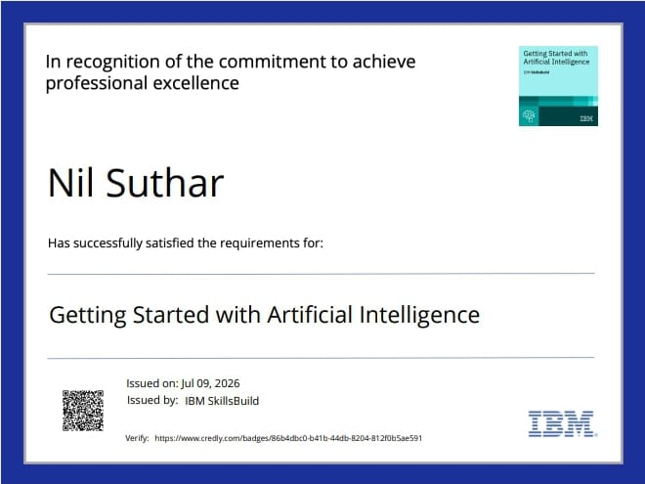
Certificates Earned:

Slide 12
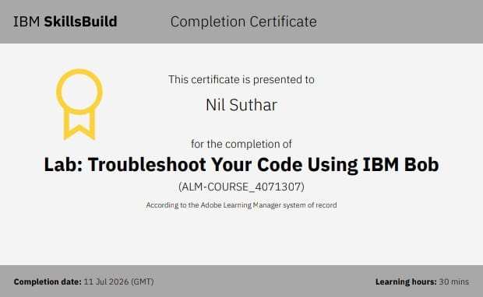
Certificates Earned:​

Slide 13


